Slide 1
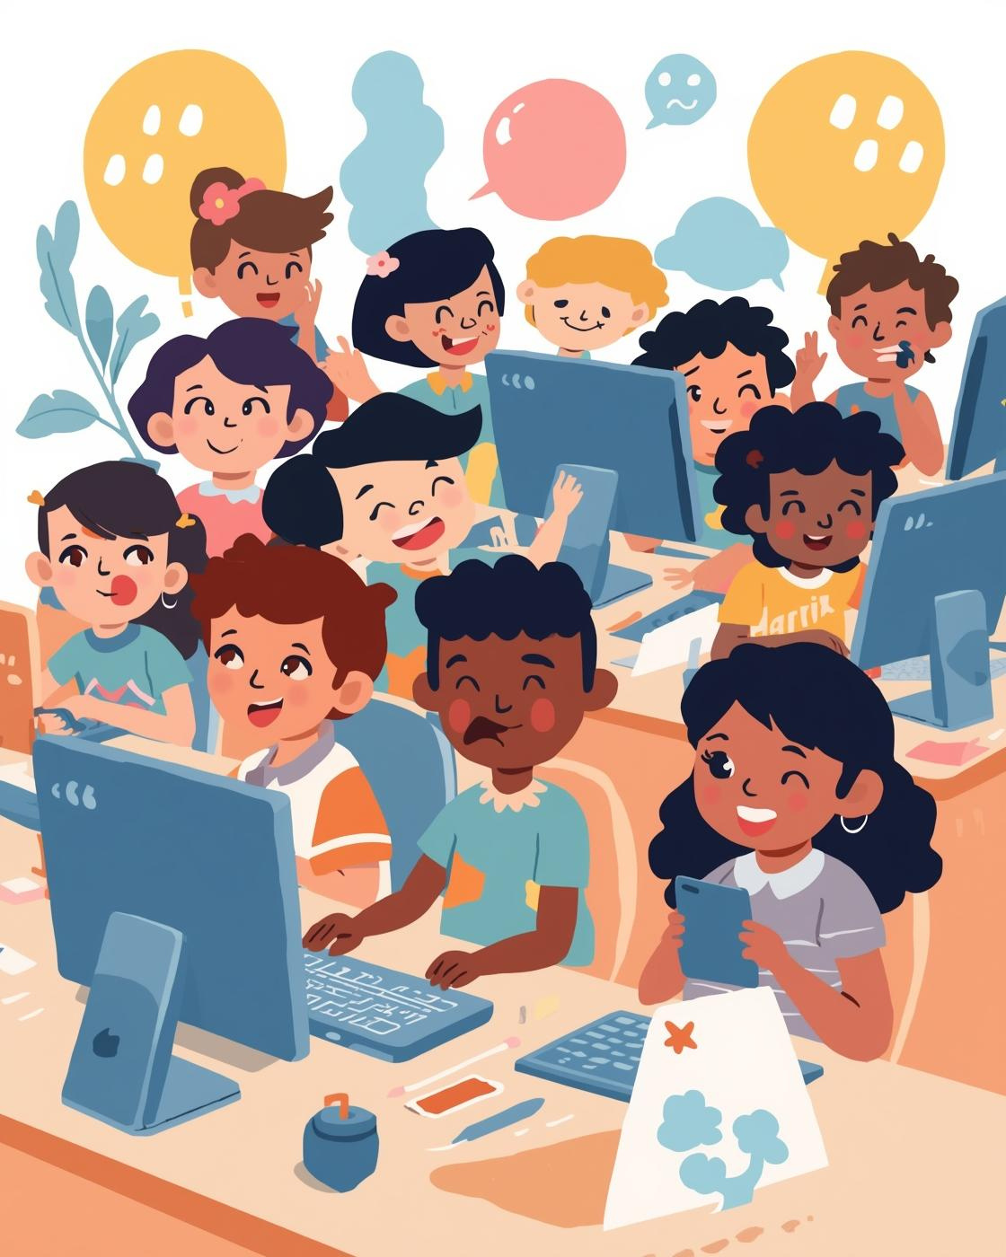

COMPUTER FUN
Computer Fundamentals
PRESENTED BY [YOUR NAME HERE]

Slide 2

What is a Computer?
It's a smart machine that helps us do many things
A computer is like a magic helper that listens to your commands. It helps us play games, watch videos, and even draw pictures!

Slide 3
"Computers are our magical assistants, turning dreams into reality with just a command."
– Unknown

Slide 4
What Can Computers Do?
  Work very fast
  Store information
  Help us learn
  Draw and create pictures
  Play games and music
  Help people communicate

Slide 5
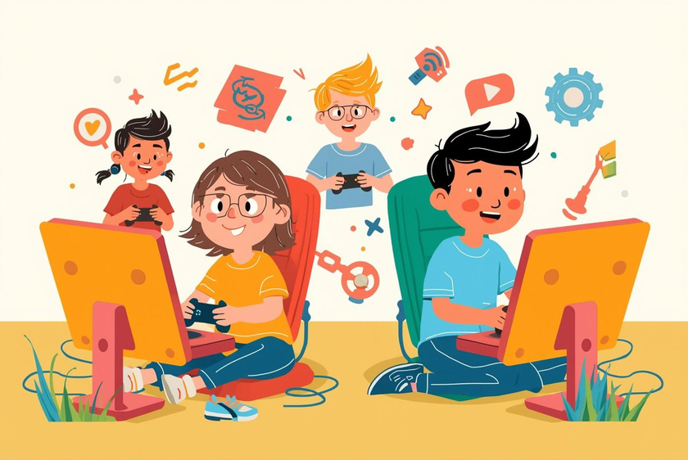
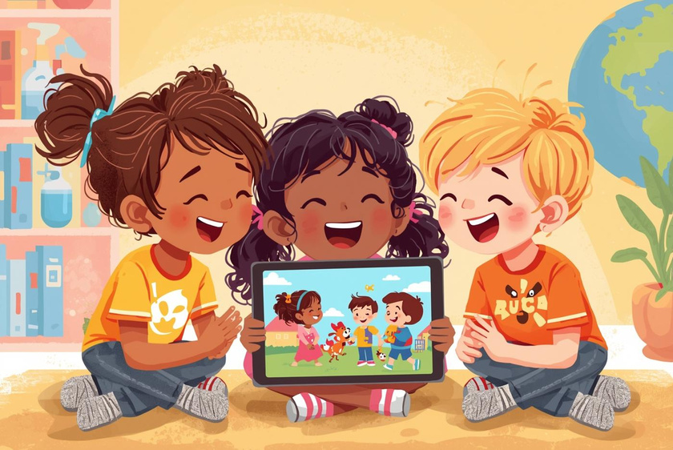
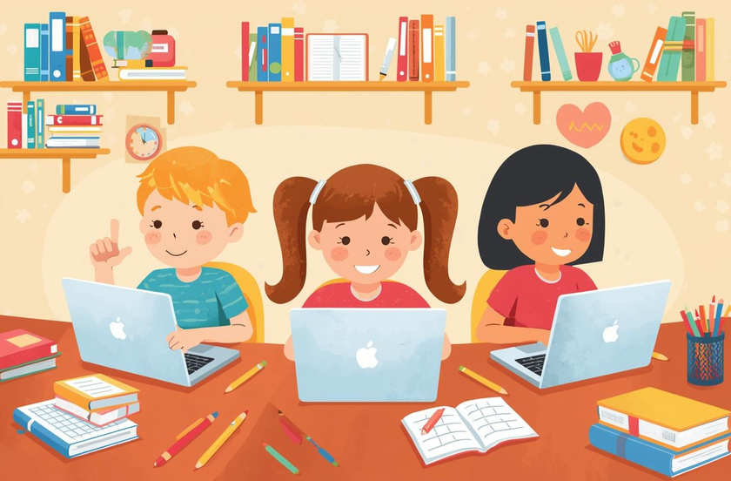
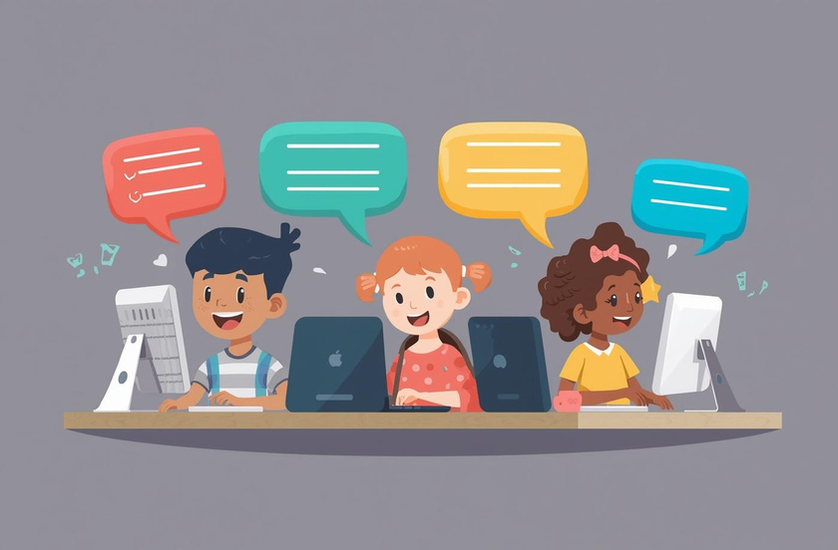
Fun things computers can do!
Play Games
Watch Cartoons
Computers let you enjoy fun and exciting games.
Enjoy your favorite cartoons with friends and family.
Help with Homework
Talk to Friends
Computers make learning fun and help with schoolwork.
Connect with friends and share fun moments online.

Slide 6
Types of Computers
Discover the different kinds of computers!
Types of Computers
  Desktop Computer – used on a desk
  Laptop – easy to carry
  Tablet – touch screen computer
  Smartphone – small computer we use every day

Slide 7
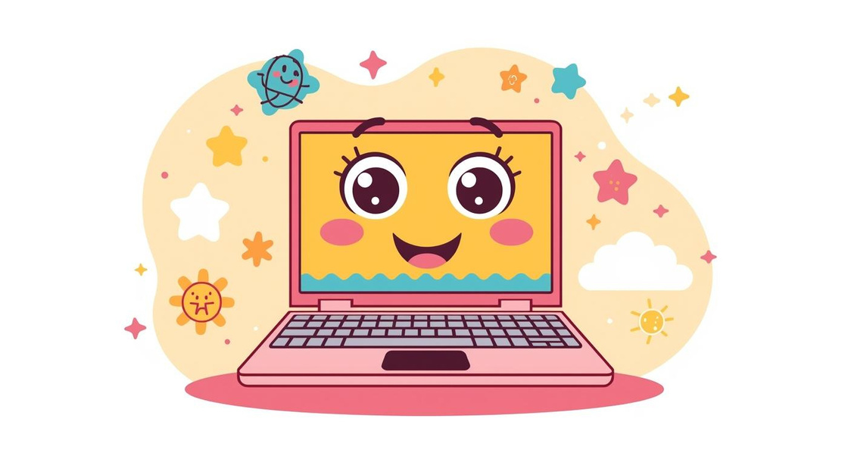
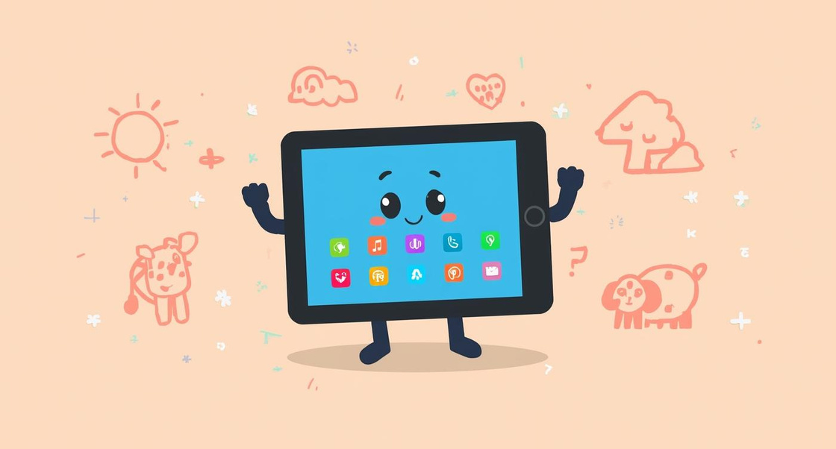
Discover Different Types of Computers
Laptop
Tablet
A laptop is a portable computer you can carry easily.
A tablet is a flat computer you can touch and swipe.

Slide 8
Basic Parts of a Computer
Discover the simple names of each part

Slide 9
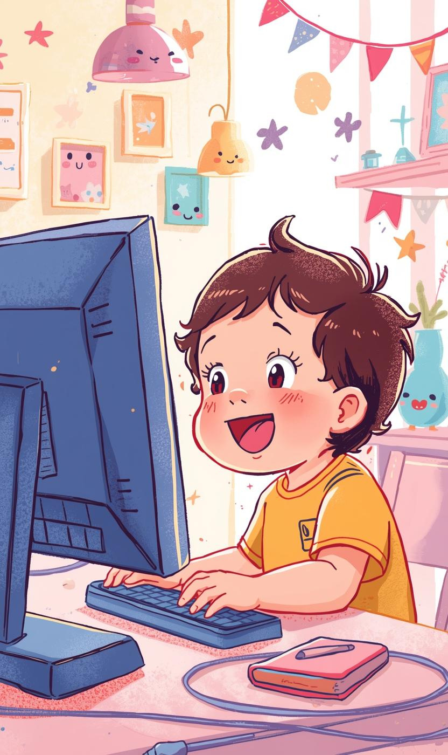
Monitor (screen)
Shows pictures and words clearly
The monitor displays vibrant images and colorful words, helping kids explore and learn exciting new things!

Slide 10
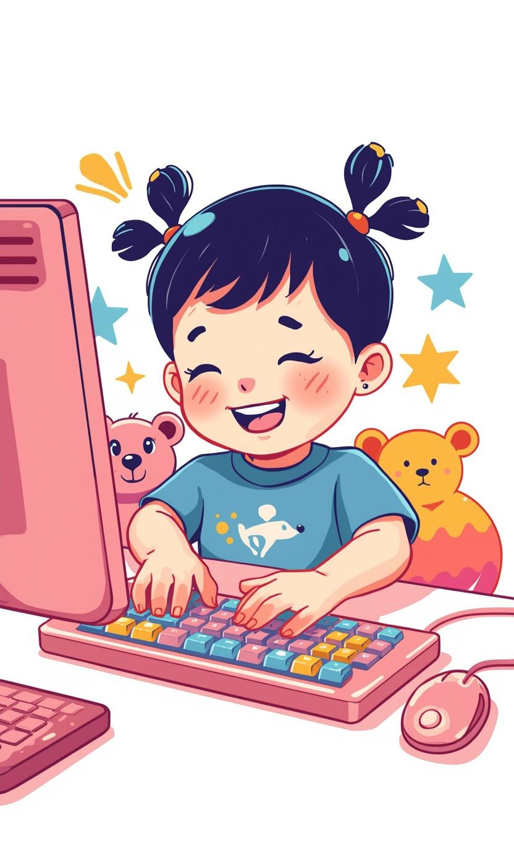
Keyboard Fun
Helps you type and create!
The keyboard is a fun tool that helps you type words, play games, and create amazing stories!

Slide 11
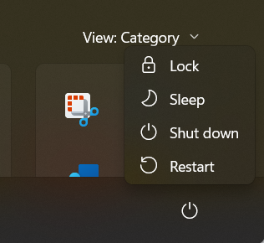
Switching On and Off
Learn how to use computers safely

Slide 12
Switching Off
Switching On
To switch off, use the shutdown button on the screen; never pull the plug.
To switch on a computer, find the power button and press it gently to start.
How to Use Computers Safely

Slide 13
"Exploring the world of computers opens doors to creativity and endless possibilities!"
– Unknown

